Slide 1

Deep Learning
02 - Shallow And Deep Networks
Fabrizio Silvestri

Slide 2

Shallow Neural Networks (Chapter 3)

Slide 3
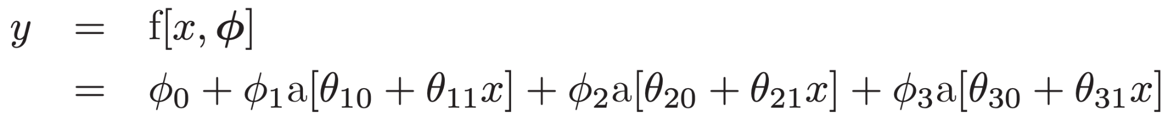
Introduction to Shallow Neural Networks
Shallow neural networks are functions y = f[x, ϕ] with parameters ϕ that map multivariate inputs x to multivariate outputs y.
We introduce the main ideas using an example network f[x, ϕ] that maps a scalar input x to a scalar output y and has ten parameters ϕ = {ϕ₀, ϕ₁, ϕ₂, ϕ₃, θ₁₀, θ₁₁, θ₂₀, θ₂₁, θ₃₀, θ₃₁}:

Slide 4
Introduction to Shallow Neural Networks
Shallow neural networks are functions y = f[x, ϕ] with parameters ϕ that map multivariate inputs x to multivariate outputs y.
We introduce the main ideas using an example network f[x, ϕ] that maps a scalar input x to a scalar output y and has ten parameters ϕ = {ϕ₀, ϕ₁, ϕ₂, ϕ₃, θ₁₀, θ₁₁, θ₂₀, θ₂₁, θ₃₀, θ₃₁}:
a[-] activation func.

Slide 5
Introduction to Shallow Neural Networks
Shallow neural networks are functions y = f[x, ϕ] with parameters ϕ that map multivariate inputs x to multivariate outputs y.
We introduce the main ideas using an example network f[x, ϕ] that maps a scalar input x to a scalar output y and has ten parameters ϕ = {ϕ₀, ϕ₁, ϕ₂, ϕ₃, θ₁₀, θ₁₁, θ₂₀, θ₂₁, θ₃₀, θ₃₁}:
Linear layers

Slide 6
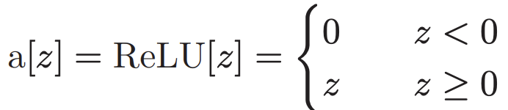
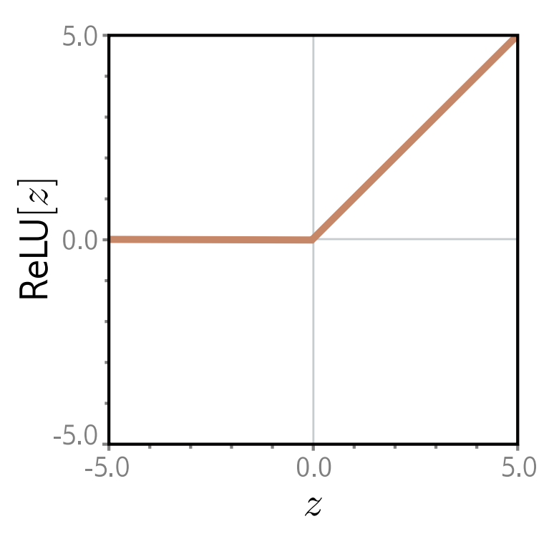
ReLU Activation
It’s the most common choice

Slide 7
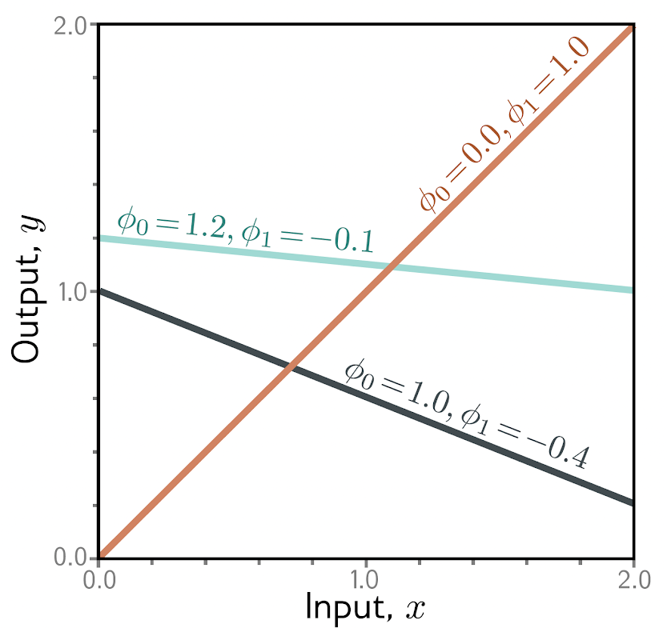
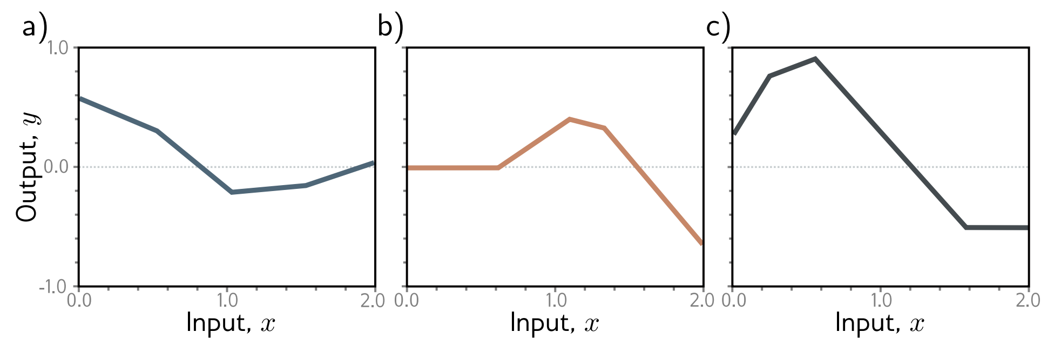
What’s the main observation we can make about the “shape” of the three functions?
Family of functions defined by the simple example
Compare with…

Slide 8
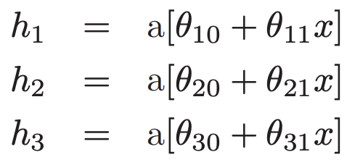
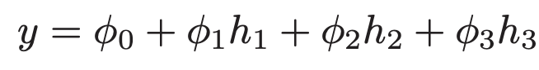
Recapping…
We introduce three temp variables we refer to h₁, h₂, and h₃ to as Hidden Units.
By combining these hidden units with a linear function we get:
Each hidden unit contains a linear function θ_{•0} + θ_{•1}x of the input, and that line is clipped by the ReLU function a[•] below zero. The positions where the three lines cross zero become the three “joints” in the final output. The three clipped lines are then weighted by ϕ₁, ϕ₂, and ϕ₃, respectively. Finally, the offset ϕ₀ is added, which controls the overall height of the final function.

Slide 9
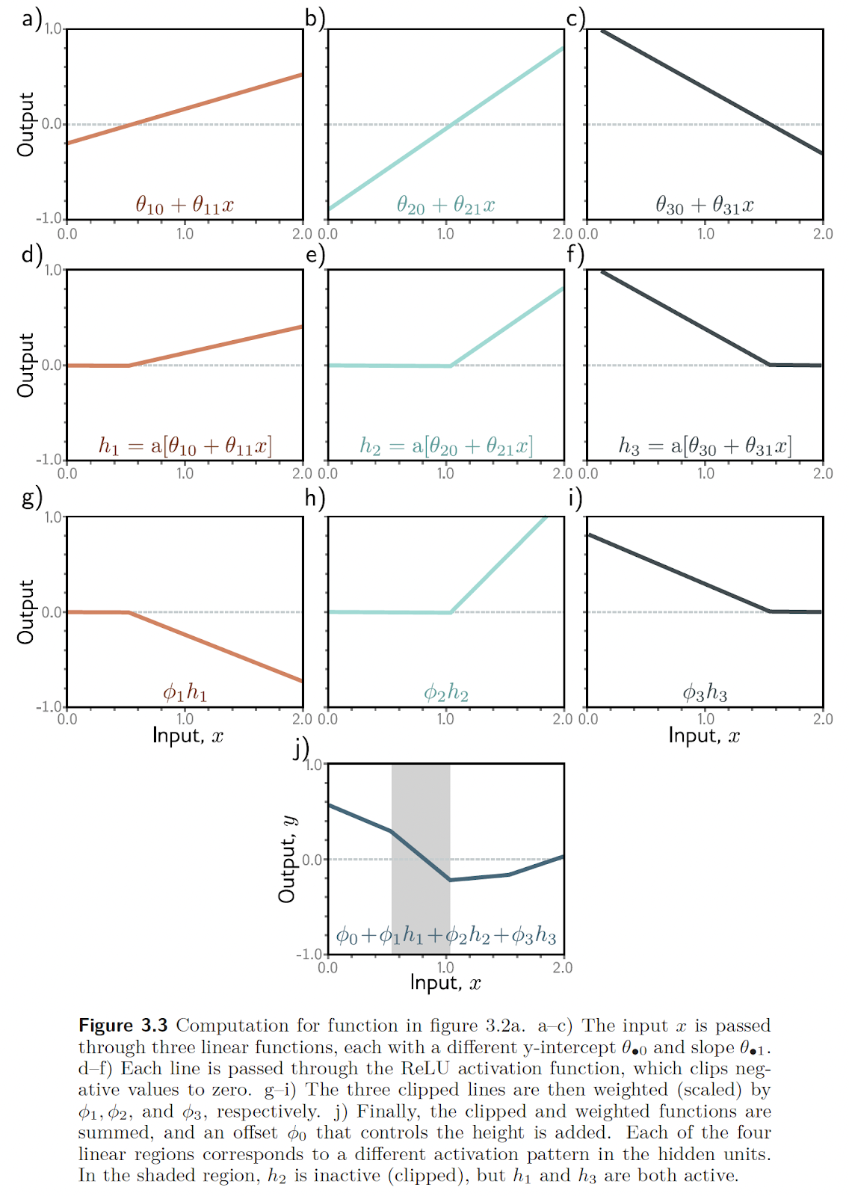

Slide 10
Summing up (pun intended 👀)…
The clipped and weighted functions are summed, and an offset ϕ₀ that controls the height is added. Each of the four linear regions corresponds to a different activation pattern in the hidden units. In the shaded region, h₂ is inactive (clipped), but h₁ and h₃ are both active.

Slide 11
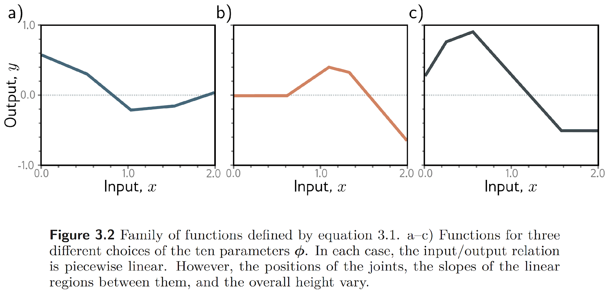
Summing up (pun intended 👀)…

Slide 12
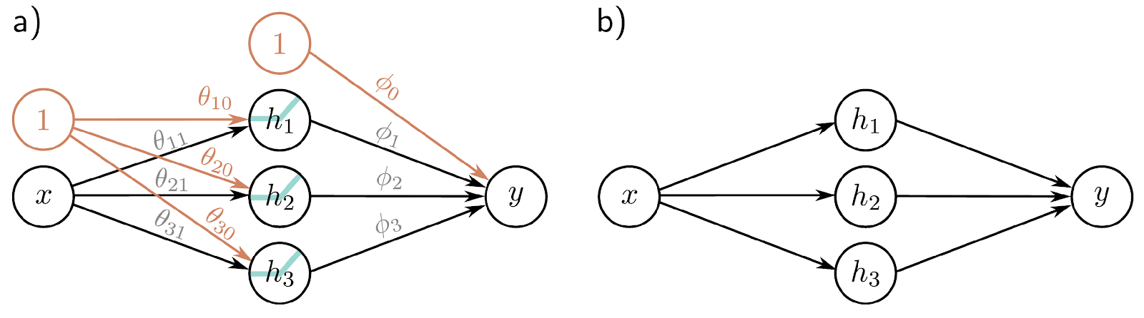
Maybe more usually depicted like this…

Slide 13
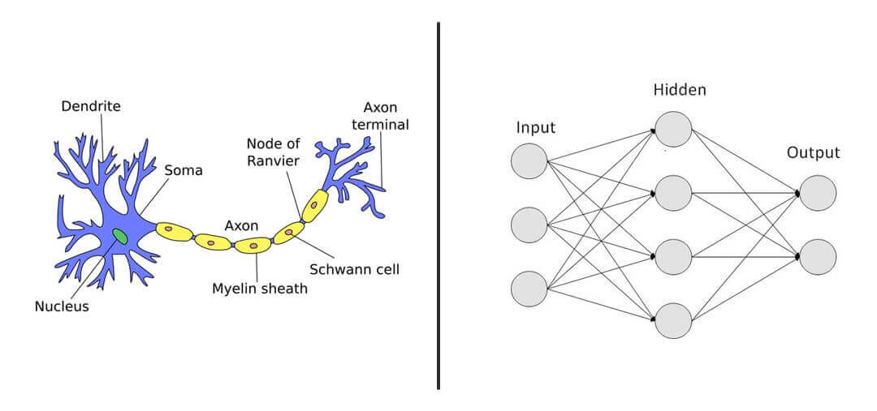
Let’s stop using this…

Slide 14
Colab time: Shallow Networks I
https://colab.research.google.com/drive/1kxlRuMPhOy_I_y5XyMbFBXIINaB65_ld

Slide 15
Colab time: Shallow Networks II
https://colab.research.google.com/drive/16G7zO9XE6d7Q99CCjISIz0CSnRmqjRvB

Slide 16
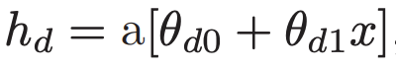
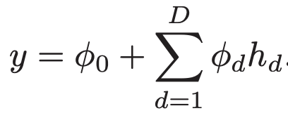
Universal Approximation Theorem
Consider the case with D hidden units where the d^{th} hidden unit is: and these are combined linearly to create the output:
The number of hidden units in a shallow network is a measure of the network capacity. With ReLU activation functions, the output of a network with D hidden units has at most D joints and so is a piecewise linear function with at most D + 1 linear regions.
As we add more hidden units, the model can approximate more complex functions.

Slide 17
Universal Approximation Theorem
With enough capacity (hidden units), a shallow network can describe any continuous 1D function defined on a compact subset of the real line to arbitrary precision.
To see this, consider that every time we add a hidden unit, we add another linear region to the function. As these regions become more numerous, they represent smaller sections of the function, which are increasingly well approximated by a line.
The universal approximation theorem proves that for any continuous function, there exists a shallow network that can approximate this function to any specified precision.

Slide 18
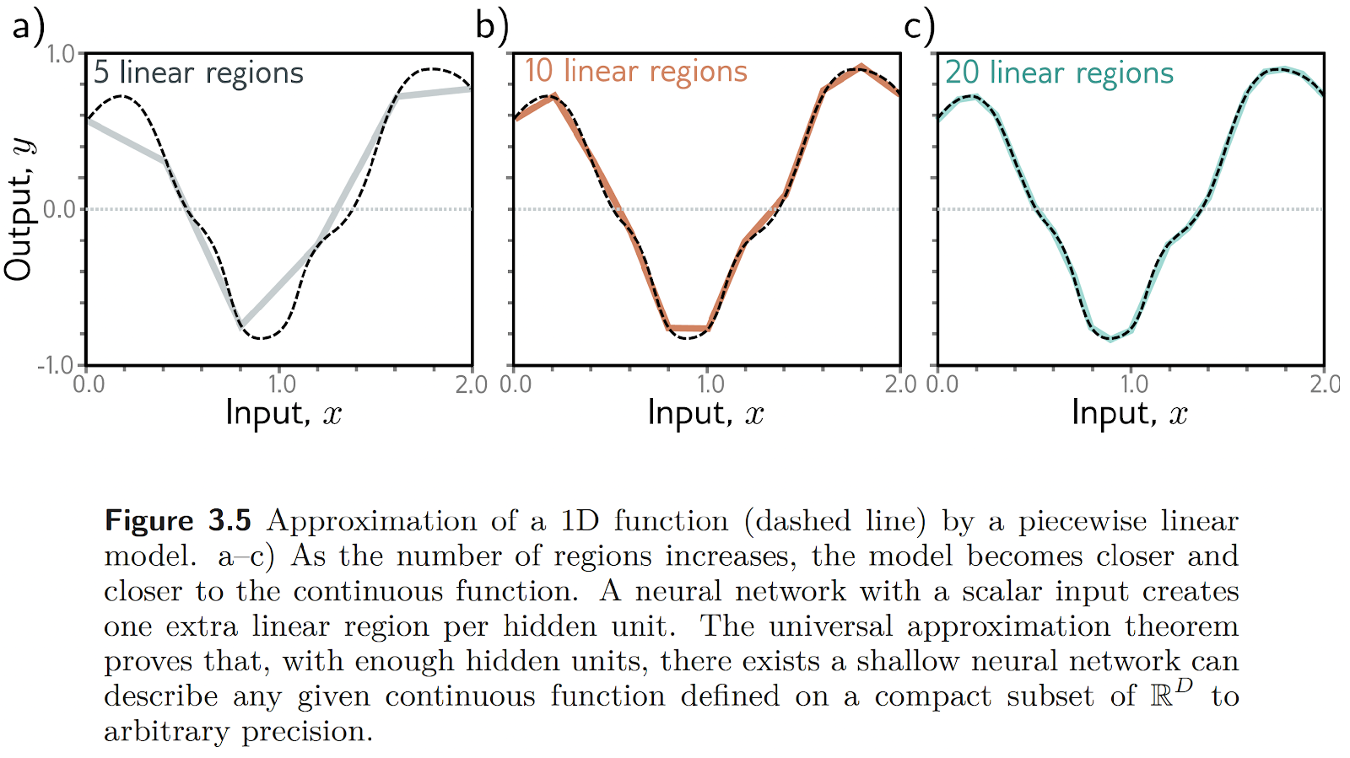
Universal Approximation Theorem

Slide 19
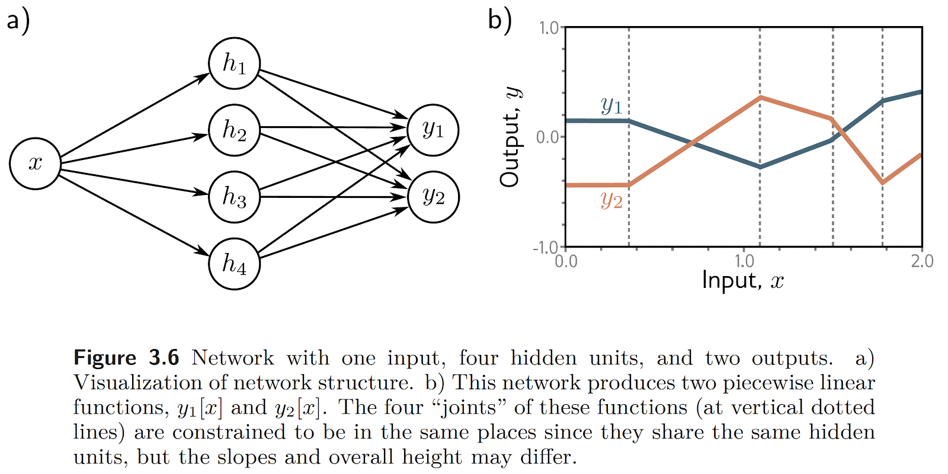
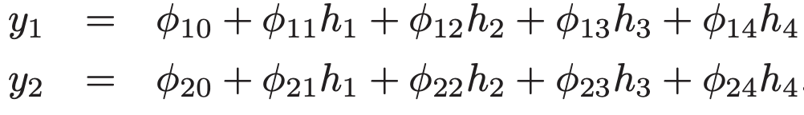
Multivariate Outputs

Slide 20
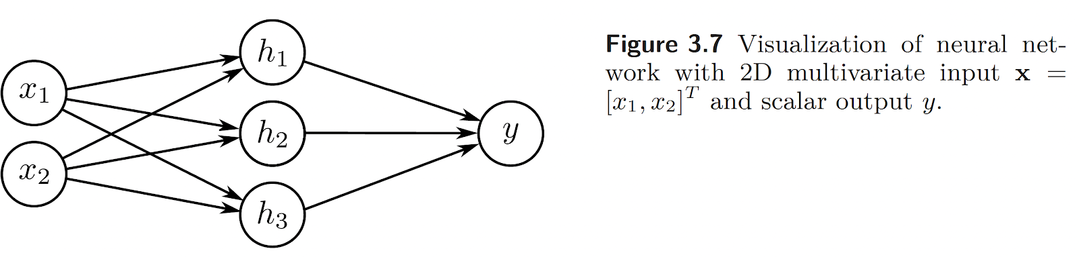
Multivariate Inputs

Slide 21
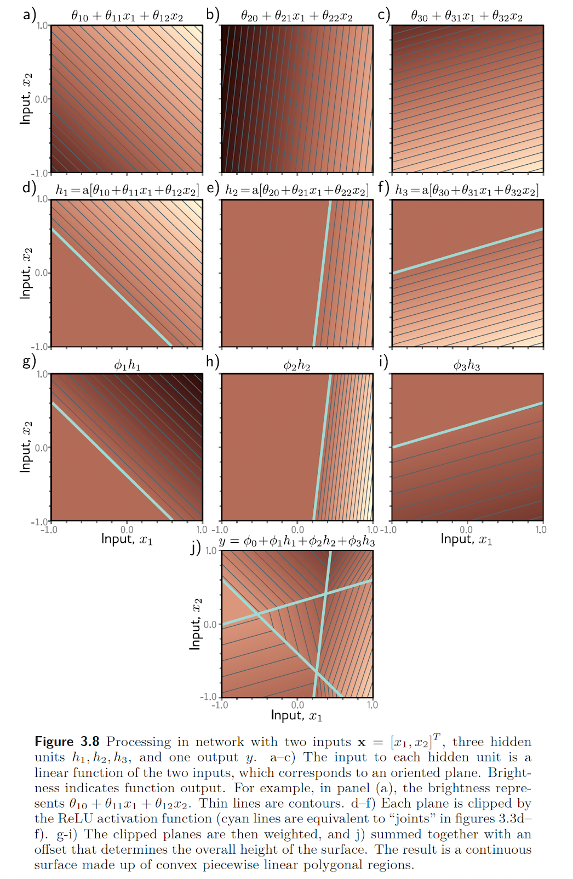
What happens when we add inputs and outputs?
Processing in network with two inputs x = [x₁, x₂]^{T}, three hidden units h₁, h₂, h₃, and one output y.
The input to each hidden unit is a linear function of the two inputs, which corresponds to an oriented plane. Brightness indicates function output.
For example, in panel (a), the brightness represents θ₁₀ + θ₁₁x₁ + θ₁₂x₂. Thin lines are contours.

Slide 22
What happens when we add inputs and outputs?
Each plane is clipped by the ReLU activation function
Cyan lines are equivalent to “joints” in the 1-D case

Slide 23
What happens when we add inputs and outputs?
The clipped planes are then weighted

Slide 24
Summing up (pun again intended 👀)…

Slide 25
Hidden Units vs. Convex Piece-wise Linear Regions
Each hidden unit defines a hyperplane that delineates the part of space where this unit is active from the Shallow network regions where it is not (cyan lines in d–f above).
If we had the same number of hidden units as input dimensions D_{i}, we could align each hyperplane with one of the coordinate axes.
For two input dimensions, this would divide the space into four quadrants.
For three dimensions, this would create eight octants, and
for D_{i} dimensions, this would create 2^D_{i} orthants.
Shallow neural networks usually have more hidden units than input dimensions, so they typically create more than 2^D_{i} linear regions.

Slide 26
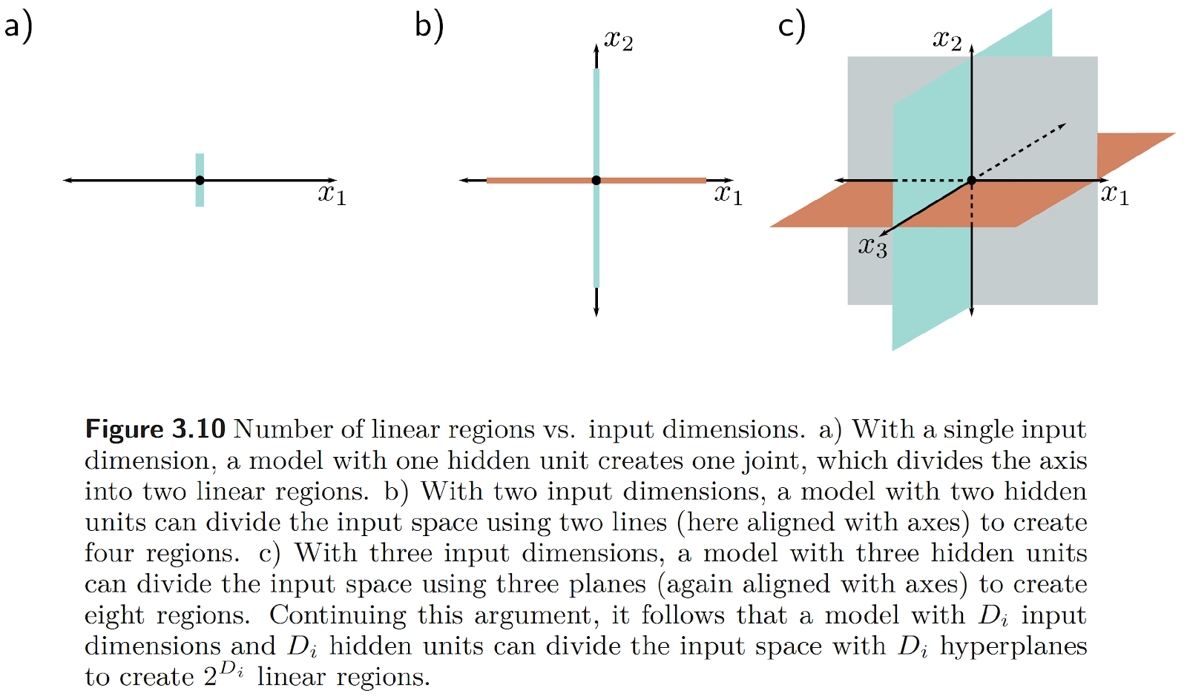
Hidden Units vs. Convex Piece-wise Linear Regions

Slide 27
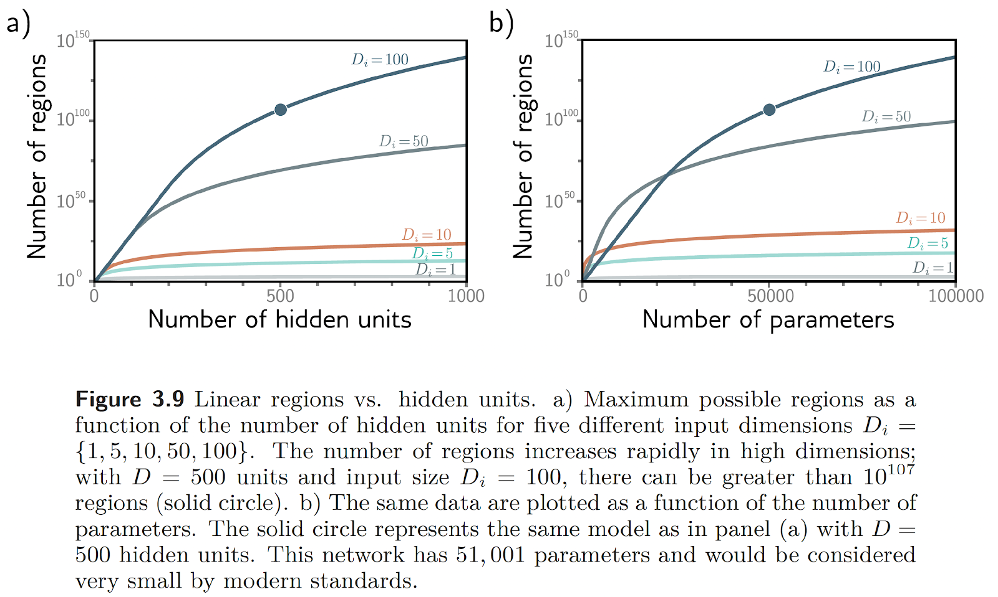
Hidden Units vs. Convex Piece-wise Linear Regions

Slide 28
Colab time: Number of Hidden Layers
https://colab.research.google.com/drive/1Y9_tCB73A4h5O77QQhPSG0AlJU-I3hDQ

Slide 29
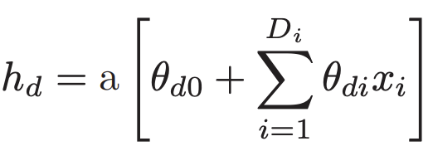
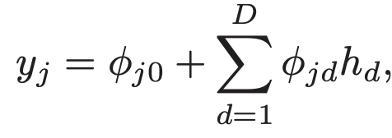
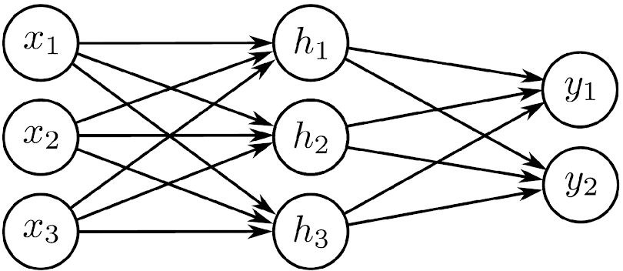
Shallow Networks: The Most General Case
We now define a general equation for a shallow neural network y = f[x, ϕ]
x ∈ ℝ^D_{i} to a multi-dimensional output y ∈ ℝ^D_{o}, h ∈ ℝ^{D}
Combined linearly to create the output:

Slide 30
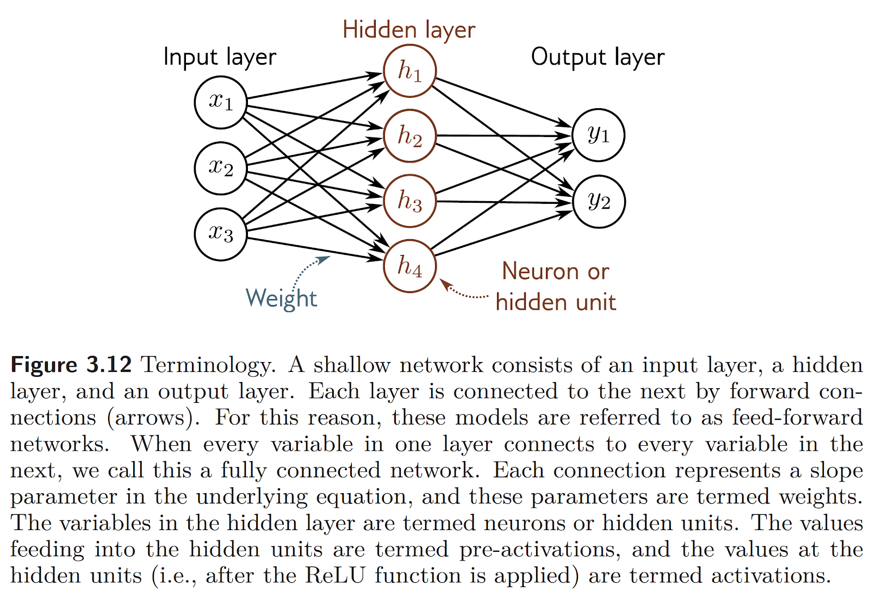
Terminology

Slide 31
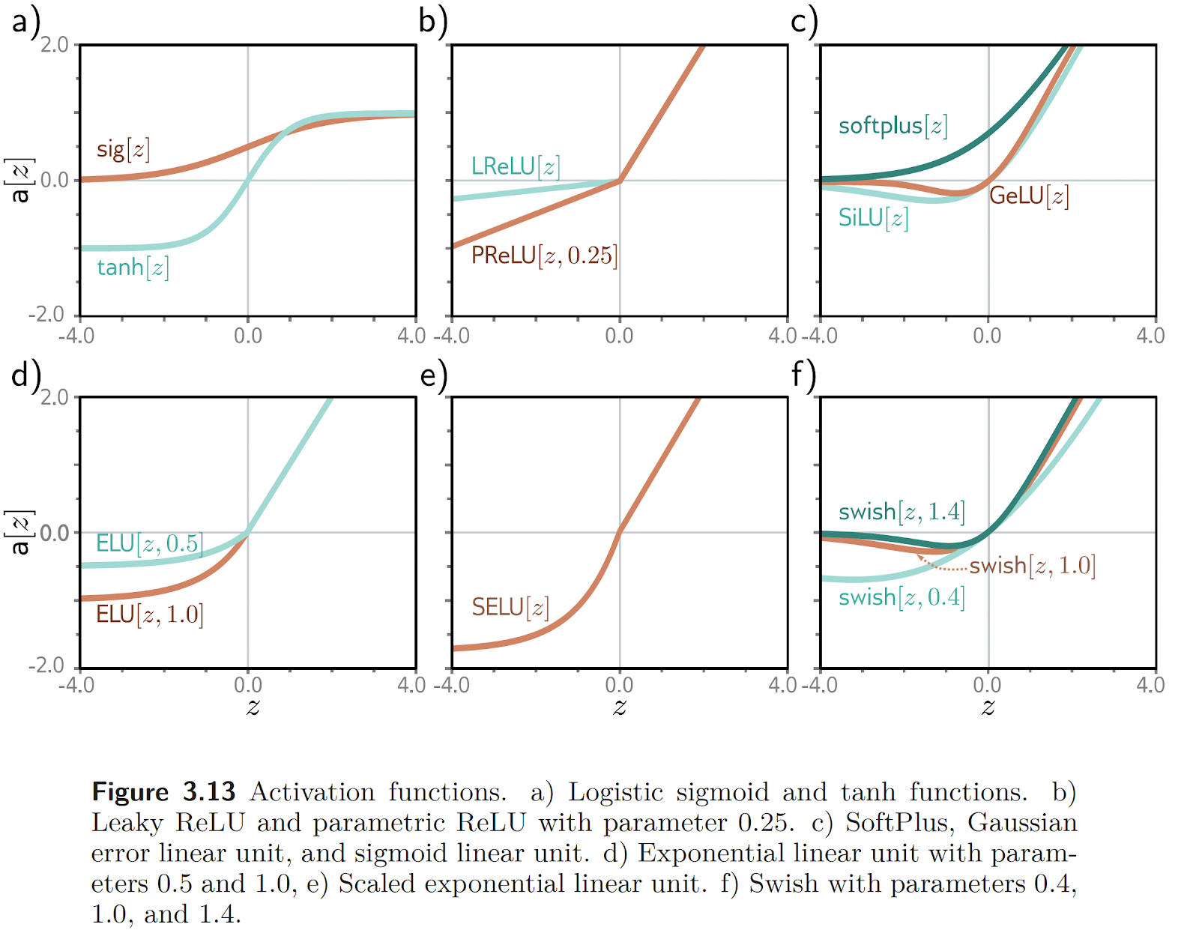
Activation Function (or Nonlinearities)

Slide 32
Colab time: Activation Functions (or nonlinearities)
https://colab.research.google.com/drive/1QPn1q5AKXnw3eKDDK1xLBS2rI9zodgs5

Slide 33
Deep Neural Networks (Chapter 4)

Slide 34
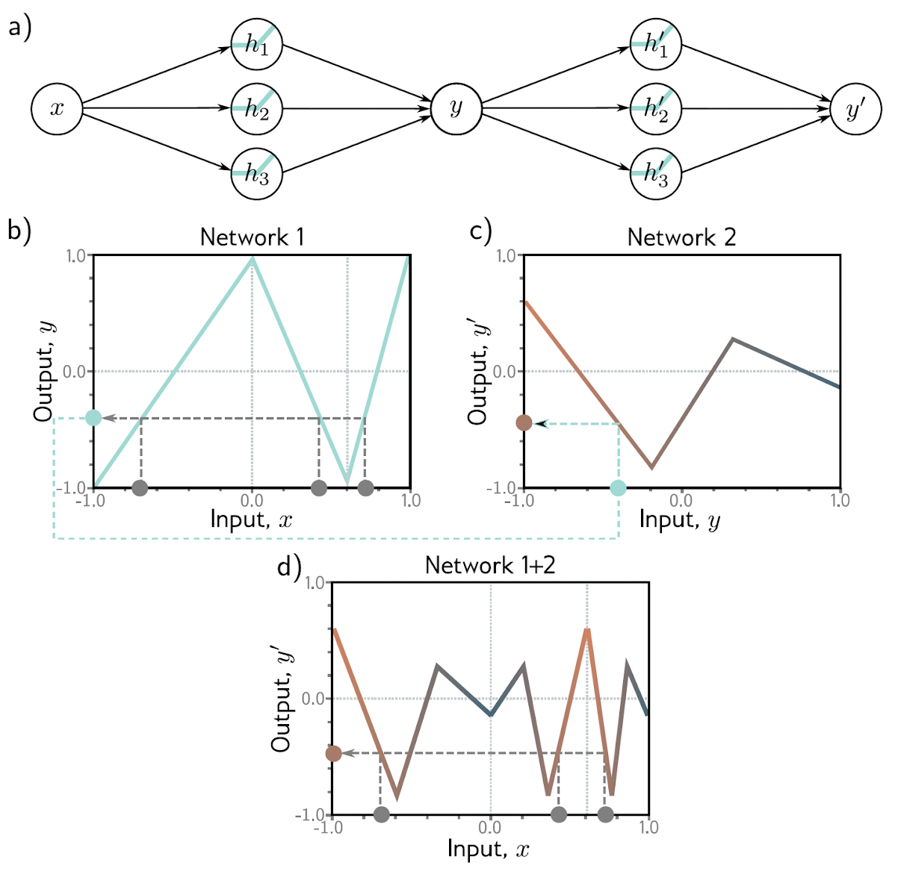
Deep Neural Networks as composition of 2 SNNs
The output y of the first network constitutes the input to the second network.
The first network maps inputs x ∈ [−1, 1] to outputs y ∈ [−1, 1] using a function comprised of three linear regions that are chosen so that they alternate the sign of their slope. Multiple inputs x (gray circles) now map to the same output y (cyan circle)
The second network defines a function comprising three linear regions that takes y and returns y′ (i.e., the cyan circle is mapped to the brown circle).
The combined effect of these two functions when composed is that (i) three different inputs x are mapped to any given value of y by the first network and (ii) are processed in the same way by the second network; the result is that the function defined by the second network in panel (c) is duplicated three times, variously flipped and rescaled according to the slope of the regions of panel (b).

Slide 35
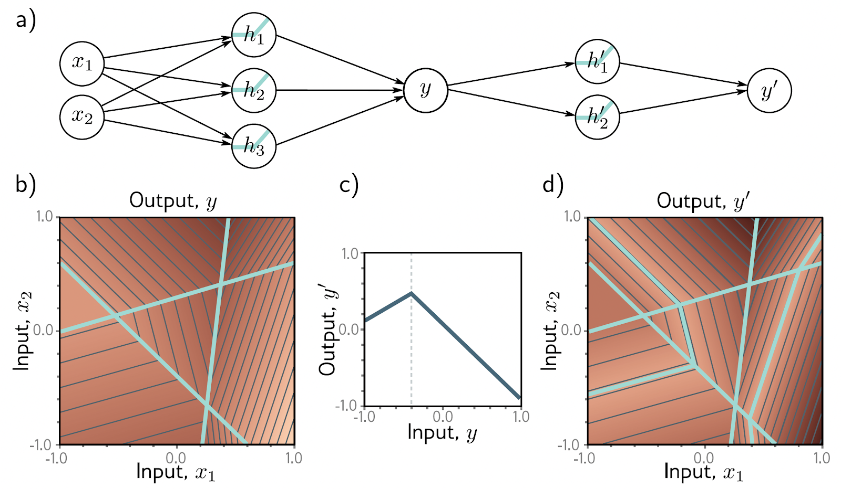
Effect on convex regions
The first network has three hidden units and takes two inputs x₁ and x₂ and returns a scalar output y. This is passed into a second network with two hidden units to produce y′.
The first network produces a function consisting of seven linear regions, one of which is flat.
The second network defines a function comprising two linear regions in y ∈ [−1, 1].
When these networks are composed, each of the six non-flat regions from the first network is divided into two new regions by the second network to create a total of 13 linear regions.

Slide 36
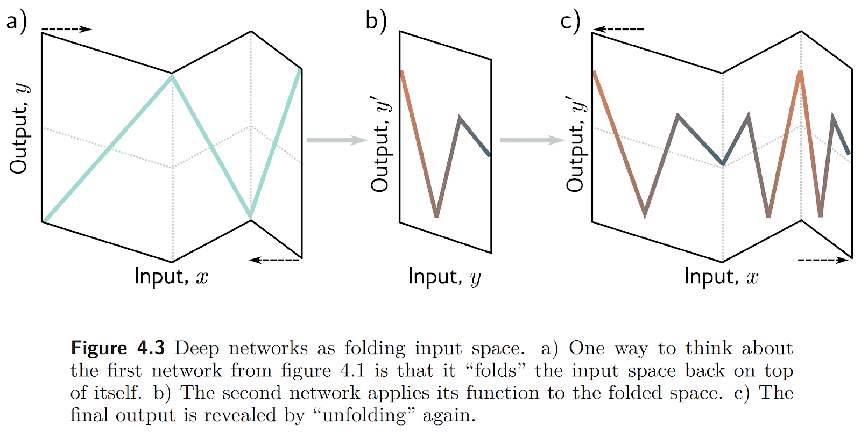

Slide 37
Colab time: Composing networks
https://colab.research.google.com/drive/1wj-dM9bemlAGRJMViAOBWK0XrUSfW8va

Slide 38
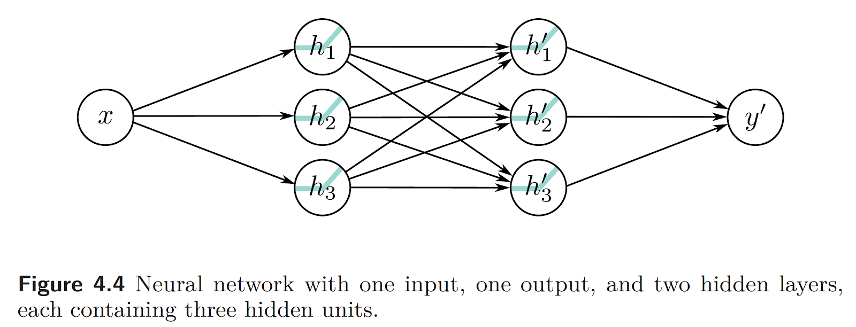
Multi Layer Perceptron (MLP)

Slide 39
Exercise
Write the equation for (assume the nonlinearity/activation is ReLU)

Slide 40
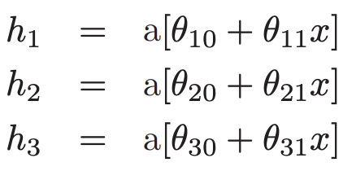
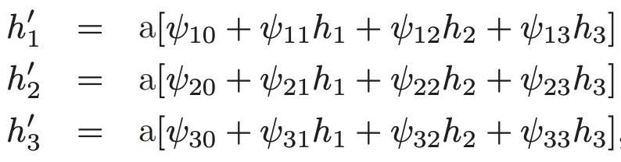
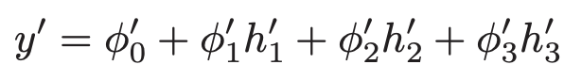
Solution
First Layer
Second Layer
Output

Slide 41
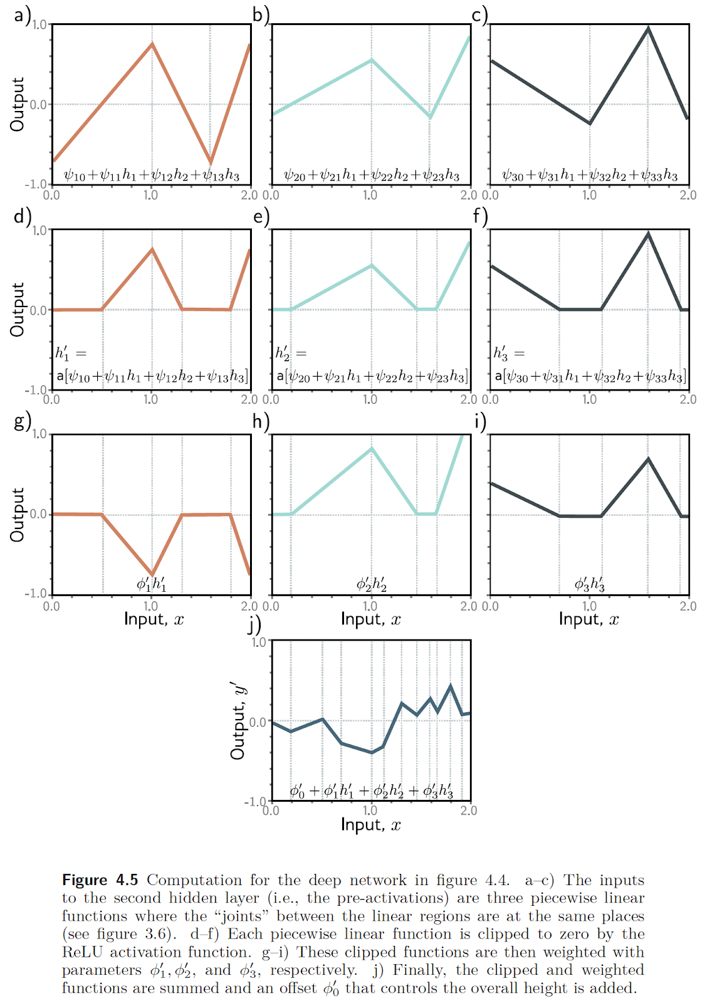

Slide 42
Summing up (ok, it’s a pun! 👀)…

Slide 43
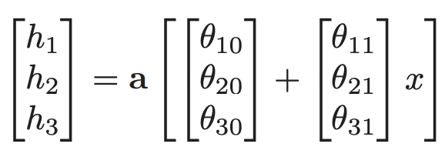
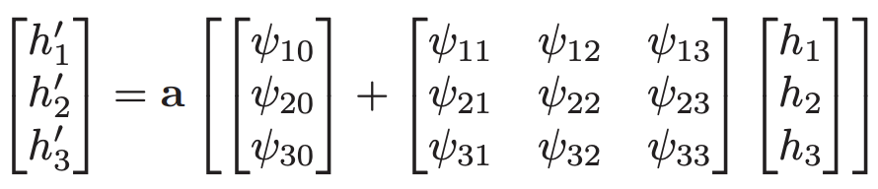
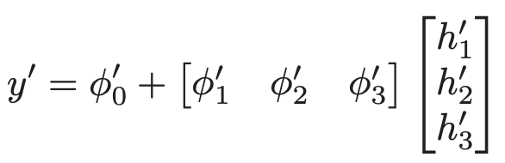
Vector Notation
First Layer
Second Layer
Output

Slide 44
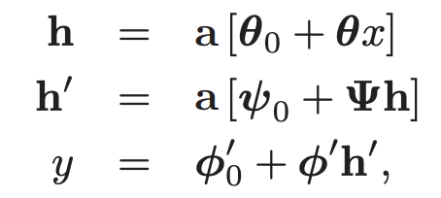
Matrix Notation

Slide 45
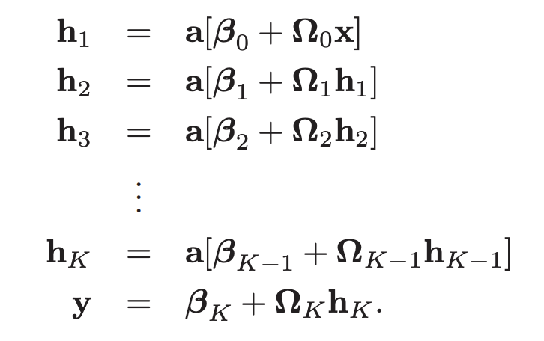
General Formulation and Notation
The parameters ϕ of this model comprise all of these weight matrices and bias vectors ϕ = {β_{k}, Ω_{k}}_{k=0}^{K}
If the k-th layer has D_{k} hidden units, then the bias vector β_{k−1} will be of size D_{k}.
The last bias vector β_{K} has the size D_{o} of the output.
The first weight matrix Ω₀ has size D₁ × D_{i} where D_{i} is the size of the input.
The last weight matrix Ω_{K} is D_{o} × D_{K}, and the remaining matrices Ω_{k} are D_{k+1} × D_{k}

Slide 46
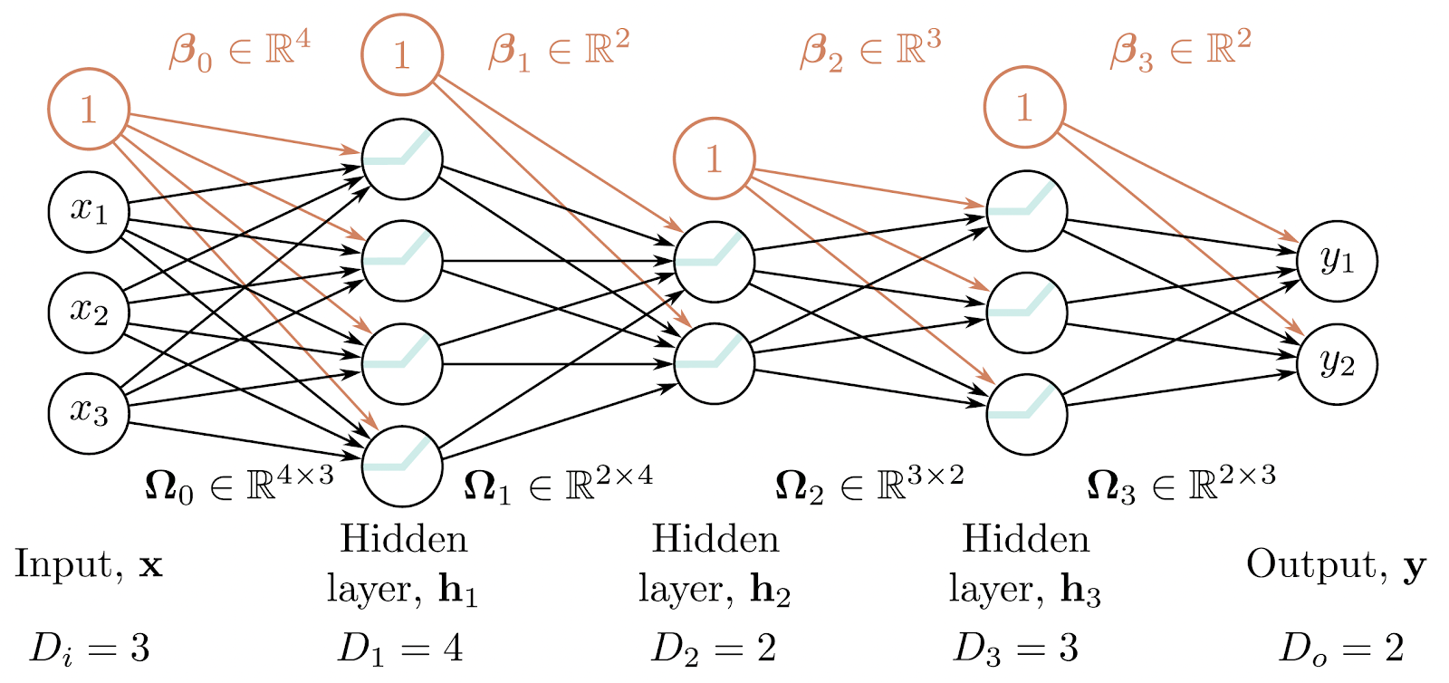
3 Hidden Layers and Matrix Notation

Slide 47
Hyperparameters
We can extend the deep network construction to more than two hidden layers
modern networks might have more than a hundred layers with thousands of hidden units at each layer (!!!)
The number of hidden units in each layer is referred to as the width of the network, and the number of hidden layers as the depth. The total number of hidden units is a measure of the network’s capacity.
We denote the number of layers as K and the number of hidden units in each layer as D₁, D₂, . . . , D_{K}.
These are examples of hyperparameters.
They are quantities chosen before we learn the model parameters (i.e., the slope and intercept terms). For fixed hyperparameters (e.g., K = 2 layers with D_{k} = 3 hidden units in each), the model describes a family of functions, and the parameters determine the particular function.

Slide 48
Depth Efficiency
Both deep and shallow networks can model arbitrary functions, but some functions can be approximated much more efficiently with deep networks.
Functions have been identified that require a shallow network with exponentially more hidden units to achieve an equivalent approximation to that of a deep network.
This phenomenon is referred to as the depth efficiency of neural networks.
This property is also attractive, but it’s not clear that the real-world functions that we want to approximate fall into this category.

Slide 49
Exercise
Imagine we have an input of size D_{i} = 6,220,800
Imagine we want to process this with a 3-layer MLP with each hidden layer of sizes respectively D₁= 512, D₂= 1,024, D₃= 512
Imagine we have a single output, D_{o}=1
Assume we use bias
How many parameters, i.e. |ϕ|, does our 3-layer MLP use?

Slide 50
Exercise
Imagine we have an input of size D_{i} = 6,220,800
Imagine we want to process this with a 3-layer MLP with each hidden layer of sizes respectively D₁= 512, D₂= 1,024, D₃= 512
Imagine we have a single output, D_{o}=1
Assume we use bias
How many parameters, i.e. |ϕ|, does our 3-layer MLP use?
Solution: 3,186,100,736 parameters
If each parameter is stored in a floating point we will need just to store the model: 12,744,402,944 bytes, i.e., ~13GB!!!!!!!

Slide 51

Why D_{i}=6,220,800?
1920x1080

Slide 52
Colab time: Deep Neural Network
https://colab.research.google.com/drive/1m2iVH3tUerXr1bMH9Yi1u7cxzKUju1AK

Slide 53
Exercise
Prove that ReLU[α·z] = α·ReLU[z]
Use this to prove that
ReLU[β₁+(λ₁·Ω₁)ReLU[β₀+(λ₀·Ω₀)x]]=λ₀λ₁·ReLU[(1/λ₀λ₁)β₁+Ω₁ReLU[(1/λ₀)β₀+Ω₀x]]
where λ₀ and λ₁ are non-negative scalars.
From this, we see that the weight matrices can be rescaled by any magnitude as long as the biases are also adjusted, and the scale factors can be re-applied at the end of the network.

Slide 54
Large, Structured Inputs
We have discussed fully connected networks where every element of each layer contributes to every element of the subsequent one.
However, these are not practical for large, structured inputs like images, where the input might comprise lots of pixels.
The number of parameters would be prohibitive, and moreover, we want different parts of the image to be processed similarly
E.g., there is no point in independently learning to recognize the same object at every possible position in the image.
The solution is to process local image regions in parallel and then gradually integrate information from increasingly large regions.

Slide 55
Training, and Generalization
A further possible advantage of deep networks over shallow networks is their ease of
Fitting:
It is usually easier to train moderately deep networks than to train shallow ones
It may be that over-parameterized deep models have a large family of roughly equivalent solutions that are easy to find.
However, as we add more hidden layers, training becomes more difficult again, although many methods have been developed to mitigate this problem.
Deep neural networks also seem to generalize to new data better than shallow ones.
In practice, the best results for most tasks have been achieved using networks with tens or hundreds of layers.
Anyway, neither of these phenomena are well understood.

Slide 56
Universal Approximation Theorem: Depth Version
There exists a network that can approximate any given continuous function on a compact subset of ℝ^{D_{i}} to arbitrary accuracy.
There exists a network with ReLU activation functions and at least D_{i} + 4 hidden units in each layer can approximate any specified D_{i}-dimensional Lebesgue integrable function to arbitrary accuracy given enough layers.
This is known as the depth version of the universal approximation theorem.
Lu, Zhou; Pu, Hongming; Wang, Feicheng; Hu, Zhiqiang; Wang, Liwei (2017). "The Expressive Power of Neural Networks: A View from the Width". Advances in Neural Information Processing Systems. Curran Associates. 30: 6231–6239. arXiv:1709.02540

Slide 57
Deep Learning
End of Lecture 02 - Shallow And Deep Networks
Fabrizio Silvestri

